Slide 1

CMR TECHNICAL CAMPUS (UGC Autonomous) (Approved by AICTE, Permanently Affiliated to JNTUH, Hyderabad, NAAC Accredited with ‘A’ Grade &NBA Accredites Kandlakoya (V), Medchal Road, Hyderabad – 501401
DEPARTMENT OF COMPUTER SCIENCE AND ENGINEERING
A
Major Project
on
INFORMATION RETRIEVAL RANKING USING MACHINE LEARNING
PRESENTED BY
M. Sai kumar Reddy (167R1A05M2)
MD Thamjeed(167R1A05F7)
Under the Guidance of
G. LAVANYA

Slide 2
What we are going to see….
Introduction
Existing system & Its Disadvantages
Proposed System & Its Advantages
Architecture
Implementation
System Requirements
Modules
UML Diagrams
User Interface
Conclusion

Slide 3
INTRODUCTION
Search
Search is basically to find something by looking or seeking carefully or thoroughly. In continuation of search there is a search engine in the world of Internet that gives a lot of documents related to the specified key words. Web search engine becomes most popular engine as the most vital access technique to the web.
Information Retrieval
IR is the process of obtaining information system resources that are relevant to an information need from a collection of those resources.IR finds the documents of an unstructured nature usually text among large collections of data stored on computers.

Slide 4
Ranking
Ranking of query results is the basic problem in IR. Among the documents groups related to the query ranking is the problem i.e. to sort the document according to some criterion that are phrased in terms of relevance of Documents related to an information need expressed in the query. Ranking is done by statistical ranking in which scores are used as the basis of ranked retrieval. The document with highest score is ranked to be first and so on. The scoring is done as the simple match or by using weighted match which gives better result in ranking

Slide 5
EXISTING SYSTEM
Information retrieval is to retrieve the information resources that what we are interested or extract whatever information we need. Now, you can retrieve any information easily. Information retrieval (IR) may deals with the organization, storage, retrieval and evaluation of information from document particularly textual information. But we cannot give the ranks to those documents. If we are giving the ranks then we can easily identify the important documents.
DISADVANTAGES
Information retrieving is very difficult task in large number of texts in a document.
Difficult to identify the important concepts or topic in a collection of documents.
The explicit rankings are always difficult to obtain or even not available in many documents.

Slide 6
PROPOSED SYSTEM
We are collecting the documents first, and then we will have to process individual words in each document to discover topics to retrieve the related data and identifying the important documents. And assign values to each topic based on the distribution of these words by using TF-IDF. Distribution of words in a document using LDA (Linear Discriminate Analysis) algorithm to generate the ranks to that particular document so, we can easily identify the important documents.

Slide 7
ADVANTAGES OF PROPOSED SYSTEM
Anyone can easily identifying the important documents in a collection of documents and retrieve the related data.
It proposes a novel model, named LDA (Linear Discriminate Analysis), achieves good performance and easy to clustering the related documents based on that ranking.

Slide 8
ARCHITECTURE

Slide 9
IMPLEMENTATION
By using,
Python 3.7.4
Django framework
MySQL
Machine Learning
-- Natural Language Processing(NLP)
-- Hybrid support vector machine & particle swarm
(SVM-PSO)

Slide 10
SYSTEM REQUIREMENTS
Hardware Requirements
System : Pentium Dual Core
Hard Disk : 500 GB
Monitor : 15’’ LED
Input Devices : Keyboard, Mouse
Ram : 1GB
Software Requirements
Operating system : Windows 7
Coding Language : Python DJango
Tool : PyCharm
Database : MySQl

Slide 11
MODULES
User:
Information retrieval is the research area in which many researcher have been done and many are still going on. The rapidly growing web pages make it very crucial to search up to date documents. As a user we have to know about the file. The files available in this website , user will get the weightage of file based on the machine learning concepts of TF and IDF. Based on the weight we can find the rank of the file.
File Vendor:
The stepping up requirements for the quick decision making has led to the need to develop a computer-assisted control in the subject area of File uploading. Here file vendor uploads the files related to our website and the user can find the weightage of that file. Based upon the weight we can find the better file. And here we can upload only text files with utf-8 characters.

Slide 12
Admin:
The aim of admin is to approve the User and File vendor . the entire data must be gathered to admin. Record large amounts of files have to take into account. Based on these data, the admin can control user and file vendor. Here the admin will maintain the details of user , vendor, file details, accuracy. If the user and vendor will enter the proper details then only the admin can activate.

Slide 13
UML DIAGRAMS
USER

Slide 14
VENDOR

Slide 15
ADMIN

Slide 16
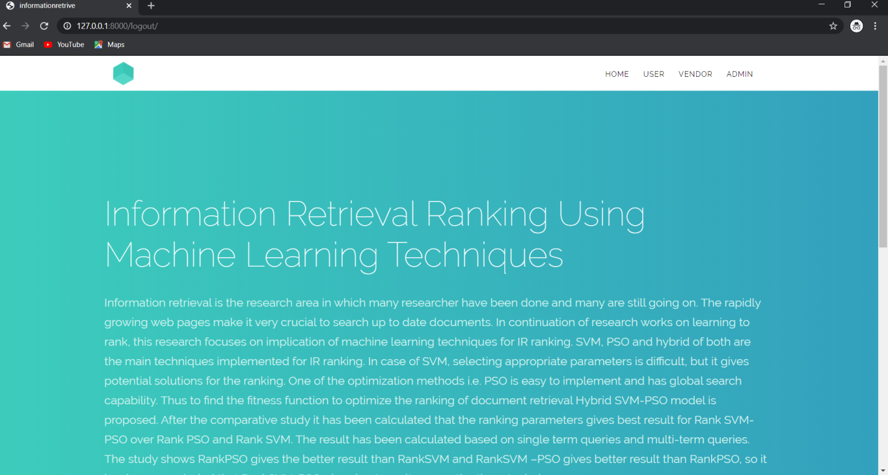
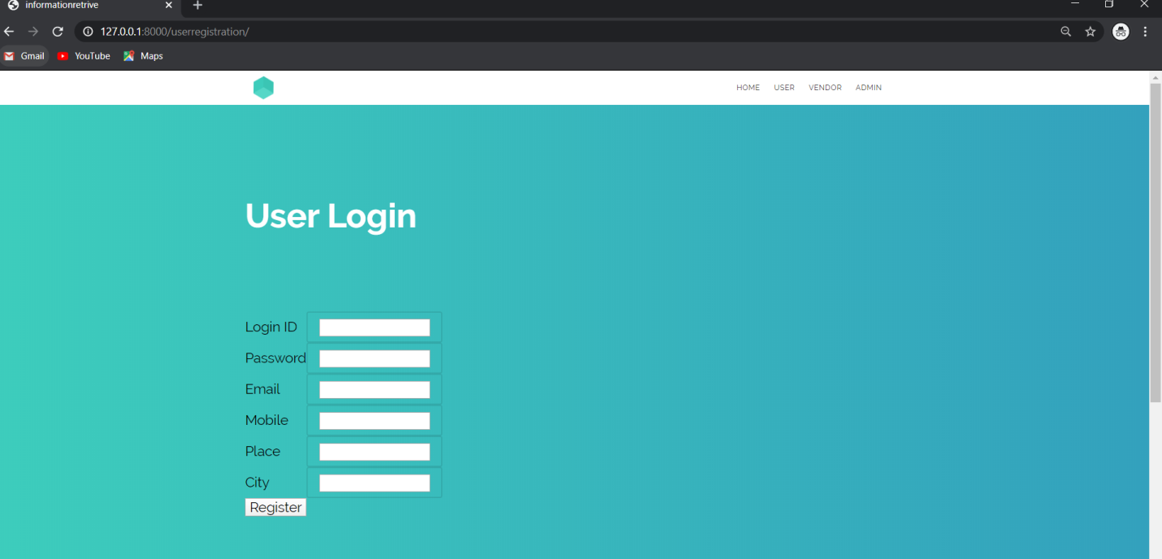
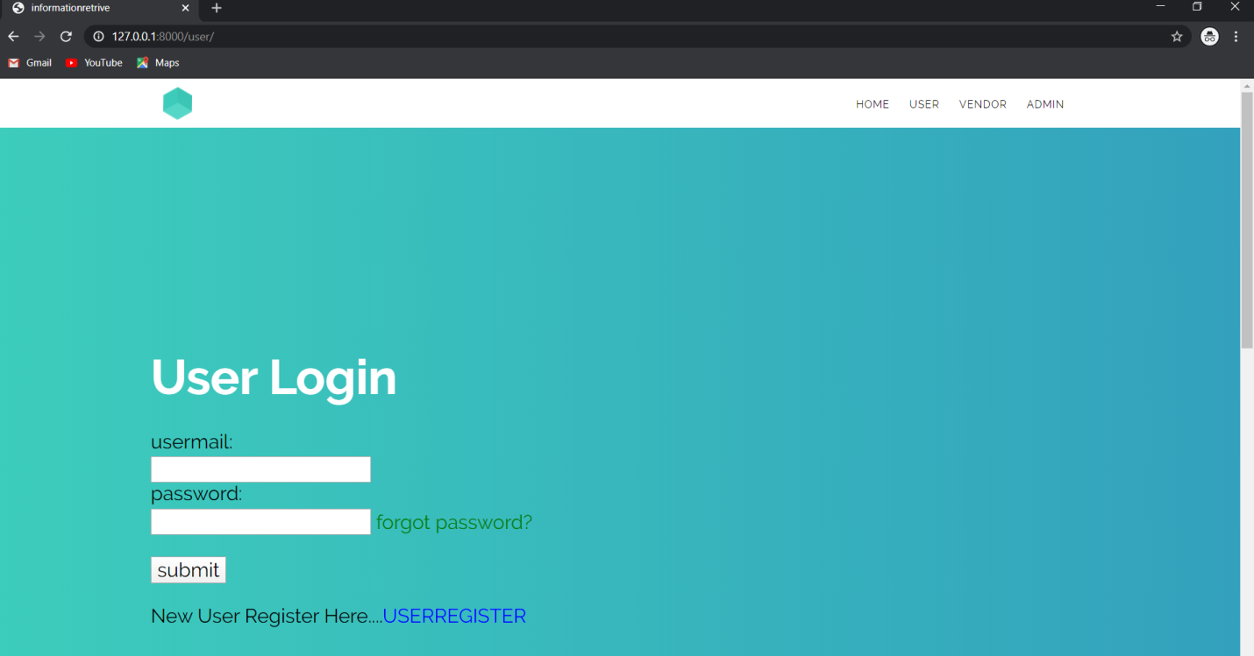
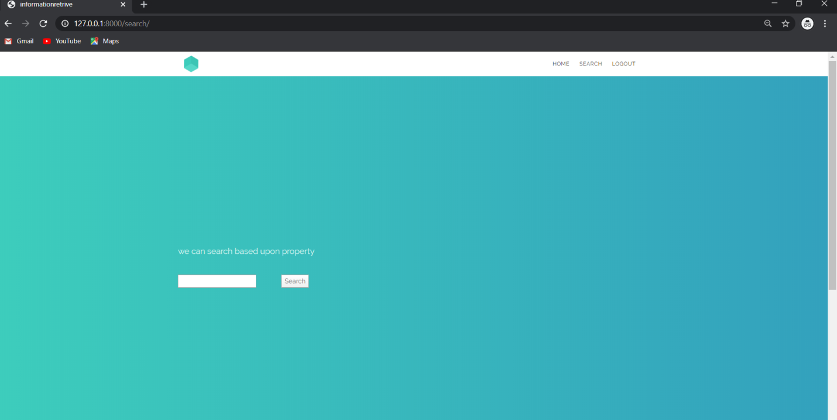
USER INTERFACE

Slide 17
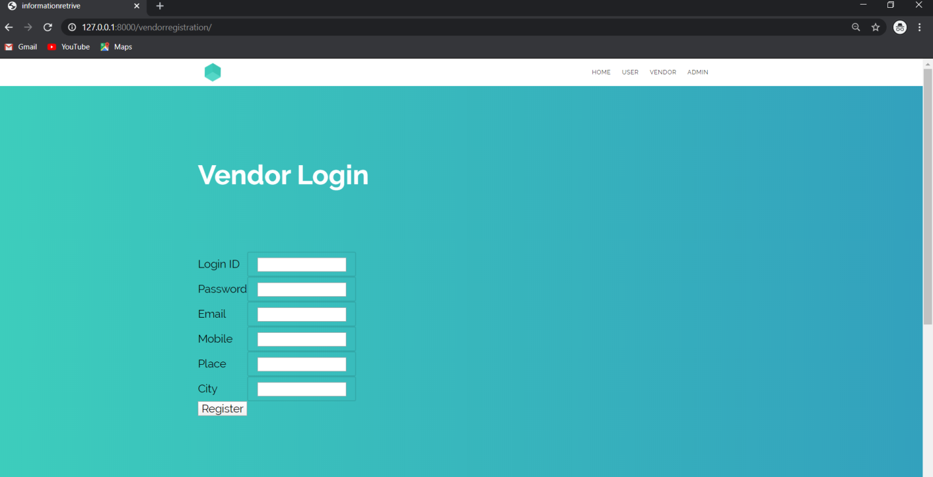
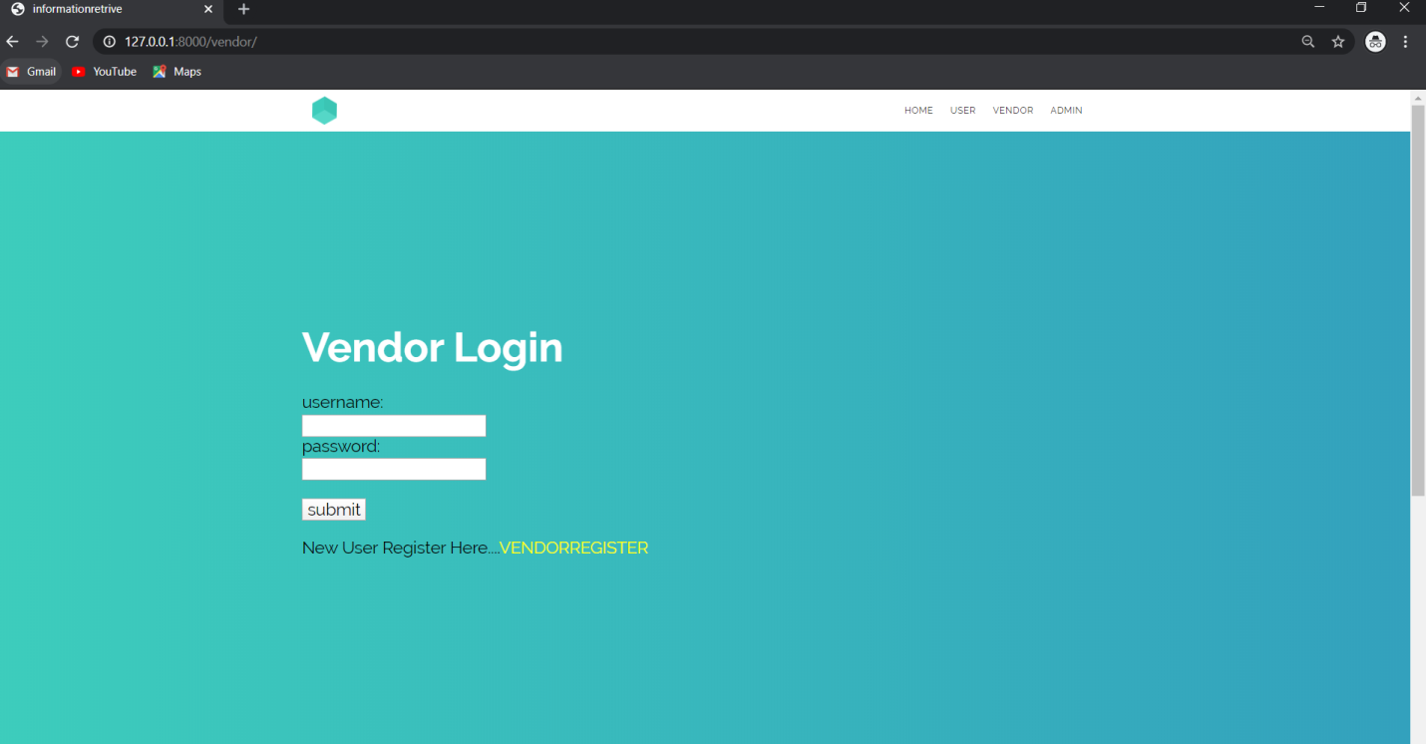
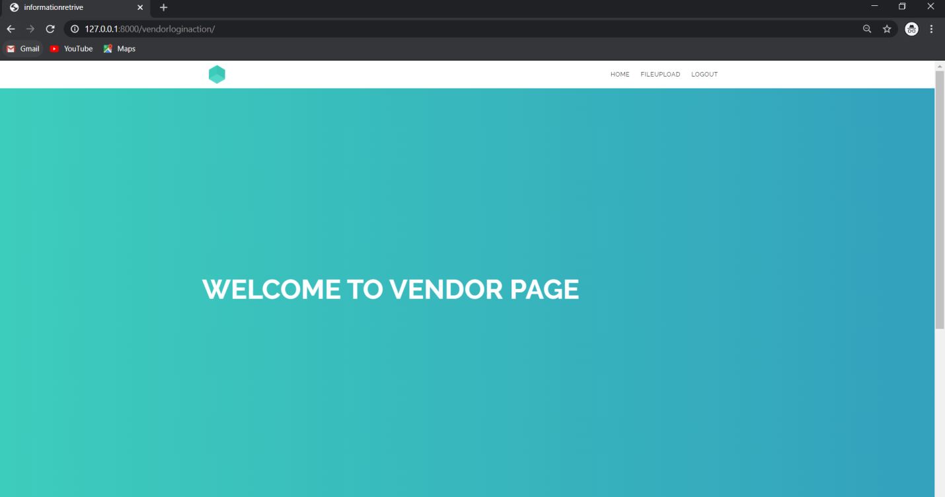
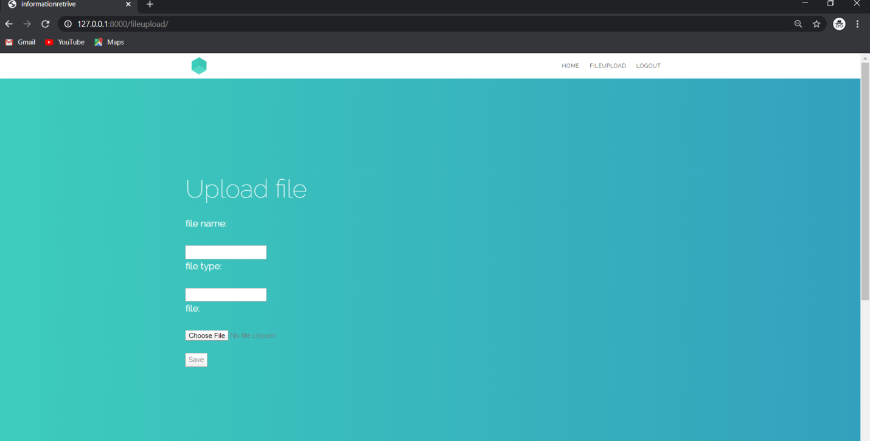
VENDOR

Slide 18
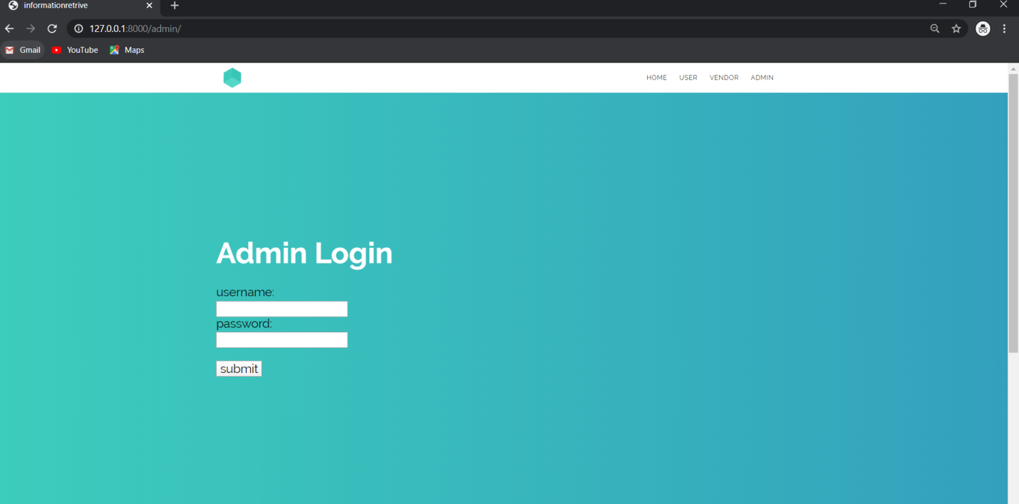
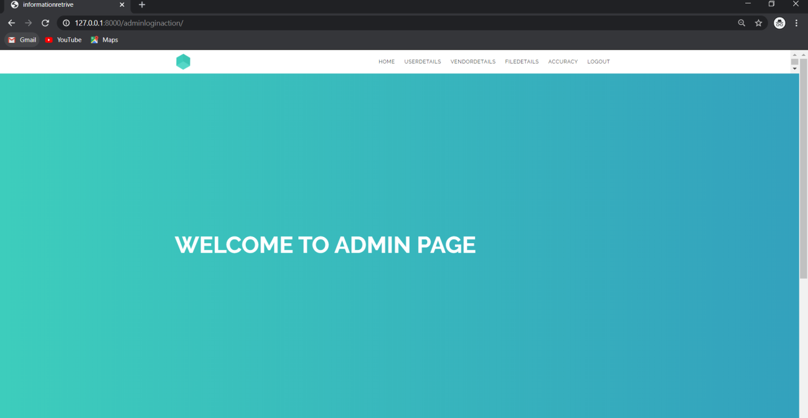
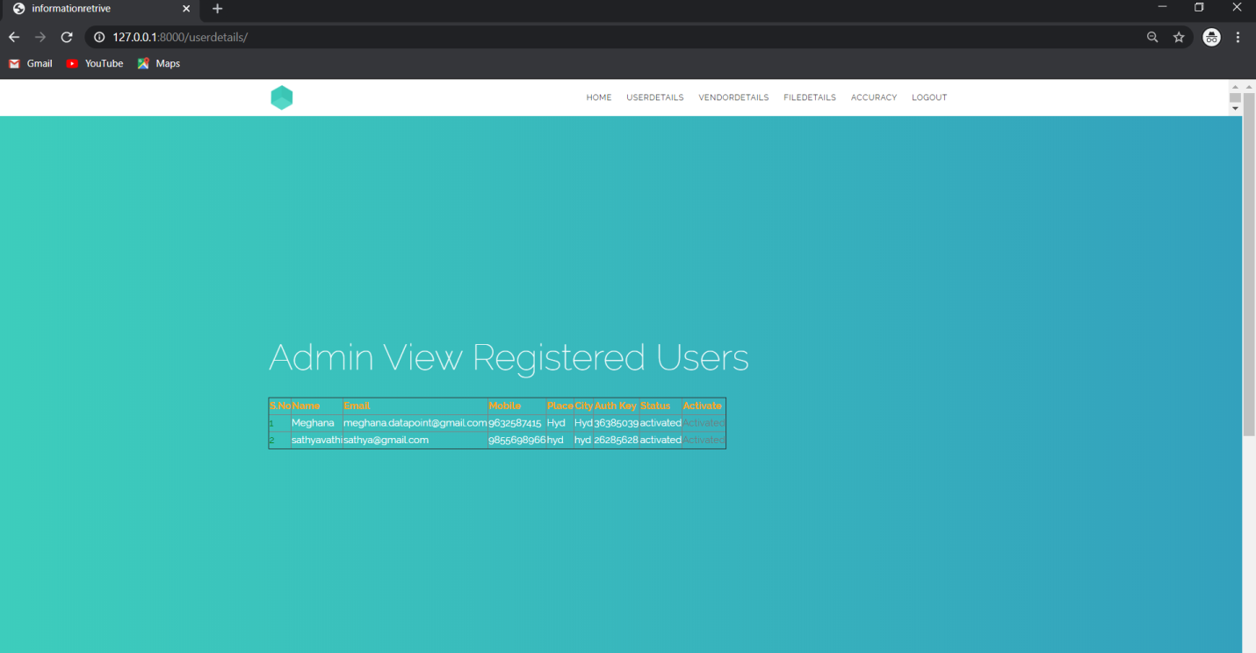
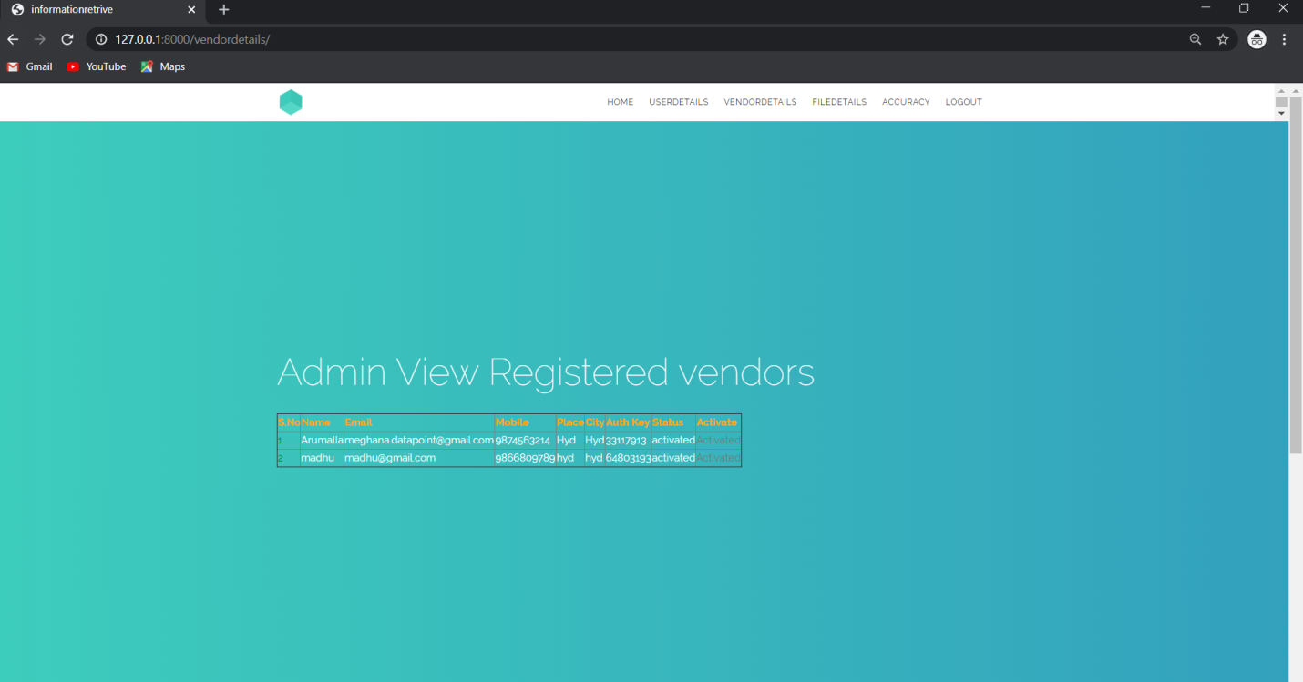
ADMIN

Slide 19
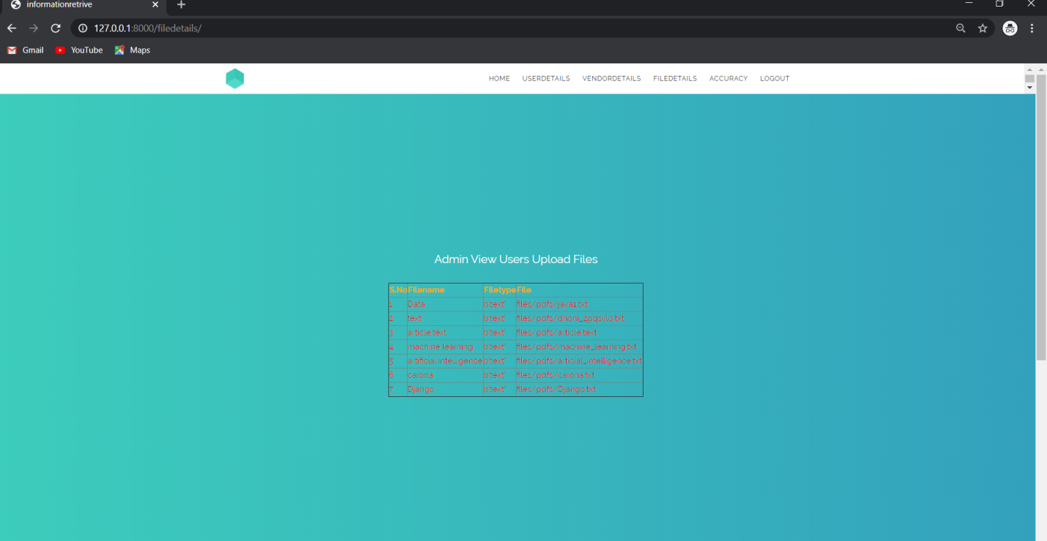
UPLOADED FILE DETAILS

Slide 20
CONCLUSION
As our system is the hybridization of both SVM and PSO, it overcomes all the previous shortcomings in ranking of information retrieval and improves the performance of the ranking system as we have seen in our evaluation tables and graphs. This paper contains the ranking system for monolingual only using SVM and PSO. The research can be further done for cross lingual and for real time retrieval system.

Slide 21
Thank You..

